Slide 1

Portfolio Completion Strategies

Slide 2
Portfolio Completion Strategies Overview
Asset Allocation Changes
Approved a 4% allocation to Portfolio Completion Strategies (PCS)
To be funded as follows:
Reduce Global Equities by 3%
Reduce Hedge Funds by 1%
Specific strategies to be vetted by PRIM investment staff and presented to Investment Committee and Board for approval.
Objective of Portfolio Completion Strategies
Improve PRIT Fund overall diversification benefits.
Enhance PRIT Fund risk/return profile.
Increase collaboration across teams.
Source unique, uncorrelated strategies without a home within current asset allocation framework.

Slide 3
Portfolio Completion Strategies
Strategies Currently Under Consideration
Alternative Risk Premia
Unconstrained/Absolute Return Fixed Income
Global Tactical Asset Allocation (GTAA)
Tangible / Intangible Assets (Real Assets)
Investments Completed To Date:
Pangora Factor Risk
Aqr Premia
GSAM

Slide 4
Portfolio Completion Strategies
An Introduction to Tangible / Intangible Assets (Real Assets)

Slide 5
Tangible and Intangible Assets
Tangible Assets (Real Assets)
Energy & Minerals
Agriculture & Forestry
Infrastructure
Property & Equipment
Real Estate
Intangible Assets (Non-Real Assets)
Royalties
Liens
Insurance risk
Other

Slide 6
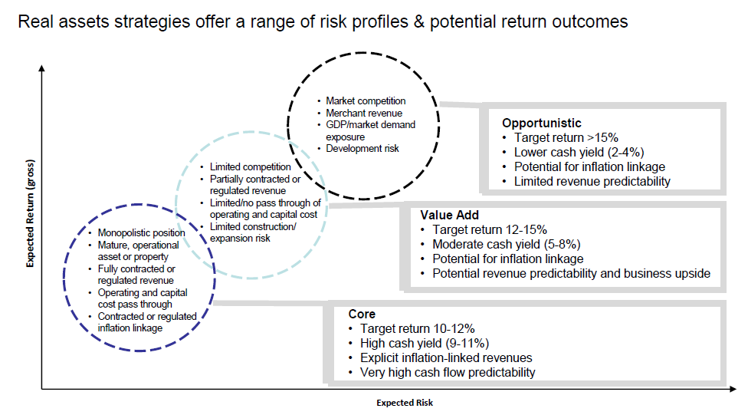
Risk/Return does not depend on physical characteristics

Slide 7
Process, Evaluation, Structuring
Process
PCS team evaluates and sources opportunities in conjunction with existing asset classes and teams.
Evaluation
Expected Return, Volatility, Correlation
Quantitative and qualitative assessments
Structuring
Risks and Returns usually fit between core & opportunistic: i.e. value add.
Structures & fees need to be an appropriate fit for risk/return profile.

Slide 8
Example: A – Infrastructure Fund
Opportunity
10 year close end infrastructure fund. Investment Ex: new build 4 lane U.S. highway.
Targeting 16% gross IRR and 2.0x gross MOIC.
Does PRIM own similar assets?
No. PCS team determines opportunity does not fit PIRM’s traditional asset classes.
PCS → Tangible / Intangible Assets → Agriculture
Evaluation:
Expected Return: 2.5%-3.5% unlevered yields.
Risk/Volatility: 90% LTV. Government Subsidized debt. Development risk.
Correlation: highway traffic is pro-cyclical
Fees
1.5%; 8% pref; 20% carry.

Slide 9
Example: B – Agriculture Fund
Opportunity
Close end farmland fund. Investment Ex: 8,000 acre farm
Does PRIM own similar assets?
No. PCS team determines opportunity does not fit PIRM’s traditional asset classes.
PCS → Tangible / Intangible Assets → Infrastructure
Evaluation:
Expected Return: 2.5%-4.5% yield; aggressive assumptions on land price appreciation
Risk/Volatility: Operating (commodity price) risk. Land development risk. 50% LTV.
Correlation: commodity prices display low correlation to other asset classes. Farmland yields are highly dependent upon interest rates (similar to real estate).
Fees
2%; 8% pref; 20% carry.

Slide 10
Pipeline
>50 opportunities evaluated in tangible / intangible asset universe
Current priorities
Permanent crops
Land banking
Mitigation credits
Areas of difficulty for PCS tangible / intangible assets
In-between risk/returns living in expensive illiquid structures
Assets linked to global GDP

Slide 11
Pipeline – Active Opportunity
Opportunity: Permanent Crops
Firm: Extremely experienced team; 2 year old firm
100% employee owned firm.
Manager can select client base
Strategy: Farmland-Plus
Value-add approach. Production and Processing.
Real asset ownership with investments in supply chain
Wine grapes, integrated dairy, blueberries, apples
Flexible investment approach helps solve problems for farmers
Targeted returns 8.5%-12% unlevered yields vs. 3%-4% for row crops
Structure: SMA
Lower fees. Direct control and ownership. Aligned incentives.
Potential to invest large amounts of capital w/ tiered fee structure.
Status: PRIM in active negotiations; likely a November IC investment candidate

